Slide 1
Face & Eye Detection Tool
OPERATING SYSTEMS
Sardar Muhammad Zeeshan Khan 27969 (CYB 4-1)
Submission SIR WAQAS AHMED

Slide 2
Contents
Introduction
History
Methodology
Implementation
Conclusion
Future Work
References

Slide 3
Introduction
Face & eye detection systems identify faces with eyes in images and videos sequences using computer.
Face & eye detection identify and detect all the faces along with eyes in an image or real time scanning.
Nowadays, face detection plays an effective role in all sectors like airports, smart rooms, intelligent robot and many more.
They need these kind of soft-wares for their security which detects the human faces.

Slide 4
HISTORY

Slide 5
History
YEAR | AUTHORS | METHODS
1973 | Kanade | First Automated System
1986 | L.Sirvoich & A.Kirby | Principle Component Analysis
1991 | M.Turk & A.Pentland | Eigenfaces
1997 | Belhumeur, P.N, Hespanha, J.P, Kriegman, D.J | Fisherfaces
2001 | Viola Jones & Micheal J.Jones | Haar,Integral,AdaBoost,Cascade
Development through History (Author’s name and their methods)

Slide 6
METHODOLOGY

Slide 7
Methodology
Viola-Jones Face Detection Algorithm
Haar Like Features
Integral Image
AdaBoost
Cascade Classifiers

Slide 8
Methodology
FACIAL RECOGNITION
Facial recognition is a form of computer vision that uses faces to attempt to identify a person or verify a person’s claimed identity. Regardless of specific method used, the facial recognition is accomplished in five steps.
Acquiring the image of an individuals face
Locate image of face
Analysis of facial image
Comparison
Match or no match.

Slide 9
Methodology
STEP 1: Acquiring the image of an individuals face
There are two ways through which we can acquire an image
Digital scan of an existing photograph.
Acquire a live picture of a subject.

Slide 10
Methodology
STEP 2: Locate image of face
Software is used to locate the faces in the image that has been used
STEP 3: Analysis of facial image
Software measure face according to peaks and valleys (nodal points)
Focuses on the inner region of the face known as the “GOLDEN TRIANGLE”.
Nodal points are used to make a face print.

Slide 11
Methodology
STEP 4: Comparison
The face print created by the software is compared to all face prints that has been stored in its database.
STEP 5: Match or No Match
Software decodes whether or not any comparisons from the comparison step are close enough to declare a possible match.

Slide 12
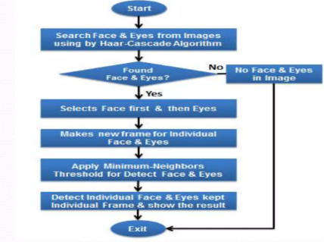
Methodology

Slide 13
Implementation

Slide 14
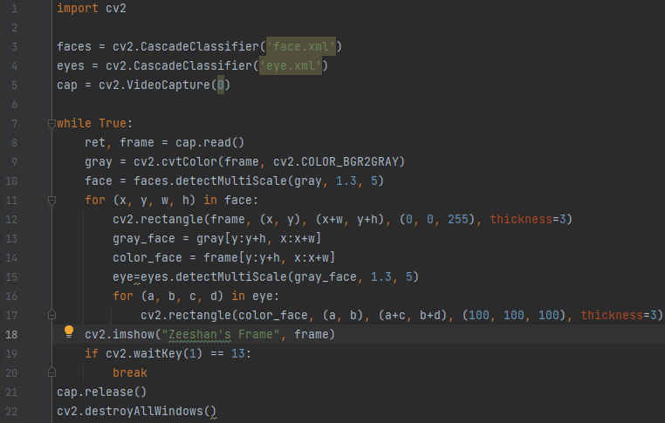
Implementation
CODE:

Slide 15
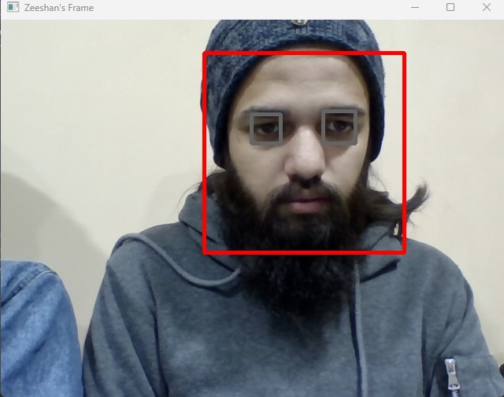
Implementation
OUTPUT:

Slide 16
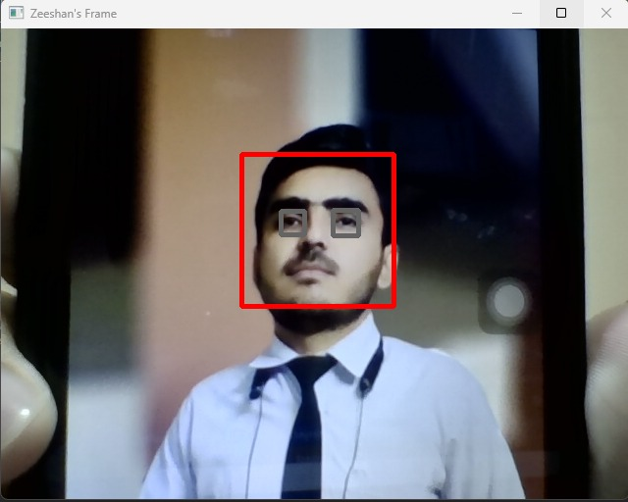
Implementation
IMAGE OUTPUT:

Slide 17
Implementation
Working Procedure:
Created a set of memory storage.
Memory storage is used for classifiers files.
Trained two Haar classifiers (XML Format) in the both character type cascade files.
First XML classifier is used for frontal face detection and second is used for open eyes detection.

Slide 18
Implementation
Process of Detect Face and Eyes:
The image which we will place in front of the camera will detect the faces if any.
Detected face and eyes will be kept individually frame.

Slide 19
Implementation
OpenCV libraries & Building Tools:
Pycharm 2022.3 Community Edition.
Language Python.
Operating System Windows 11 home
Libraries: OpenCV-python with some modules.

Slide 20
Conclusion

Slide 21
Conclusion
The main purpose of this research is to develop a system of Adaptive Face and Eye detection.
The strong sites of my process is “My system can detect faces in all frontal face in images and real life and adaptive face detection system.”
Weakness of my process is “ We cannot detect face well in different pose variation situations.”

Slide 22
Future Work

Slide 23
Future Work
I can improve my methods and increase its efficiency by following couple of advancements.
Improvements will be:
To improve the weak points of Haar-classifiers for a more stable solution of detection.
Side face detection and recognition in the real time.

Slide 24
References
Eye-Trackers in IS Research Proceedings of the Eighteenth Annual Pre-ICIS Workshop on HCI Research in MIS, Munich, Germany, December 15, 2019
International Journal of Computer Science & Engineering Survey (IJCSES) Vol.2, No.3, August 2011
journal, i. (2013) "Real Time Embedded Implementation of Face Recognition Using Beagle Board.", International Journal of Engineering Sciences &amp; Research Technology, p.
Eye Tracking Analysis Using Convolutional Neural Network Eye Tracking Analysis Using Convolutional Neural Network (2022).
Klaib, A. et al. (2021) "Eye tracking algorithms, techniques, tools, and applications with an emphasis on machine learning and Internet of Things technologies", Expert Systems with Applications, 166, p. 114037. doi: 10.1016/j.eswa.2020.114037.
Mahoney, E. et al. (2018) "Eye Tracking as a Tool for the Detection of Simulated Memory Impairment", Journal of Applied Research in Memory and Cognition, 7(3), pp. 441-453. doi: 10.1016/j.jarmac.2018.05.004.
Real-time eye tracking using a smart camera (2022). Available at: https://ieeexplore.ieee.org/abstract/document/6176373 (Accessed: 22 December 2022).
OpenFace: An open source facial behavior analysis toolkit (2022)
El Kaddouhi, S., Saaidi, A. and Abarkan, M. (2017) "Eye detection based on the Viola-Jones method and corners points", Multimedia Tools and Applications, 76(21), pp. 23077-23097. doi: 10.1007/s11042-017-4415-5.
Eye tracking as an accessible assistive tool (2022). Available at: https://ieeexplore.ieee.org/abstract/document/5617660 (Accessed: 22 December 2022).

Slide 25
THANKYOU!!

